Slide 1
Tech Fiesta- TechTalk
PRESENTATION
DYNAMIC IMAGE RECOGNITION
Submitted by
RISHABH MEHRA
RA1711008010321

Slide 2
DYNAMIC IMAGE RECOGNITION
Image recognition, in the context of machine vision, is the ability of software to identify objects, places, people, writing and actions in images. Computers can use machine vision technologies in combination with a camera and artificial intelligence software to achieve image recognition.
Computer vision uses image processing algorithms to analyze and understand visuals from a single image or a sequence of images.

Slide 3
Motion detection and tracking with Python and OpenCV
Main Logic :
Videos can be treated as stack of pictures called frames. Here we are comparing different frames(pictures) to the first frame which should be static(No movements initially). We compare two images by comparing the intensity value of each pixels.

Slide 4
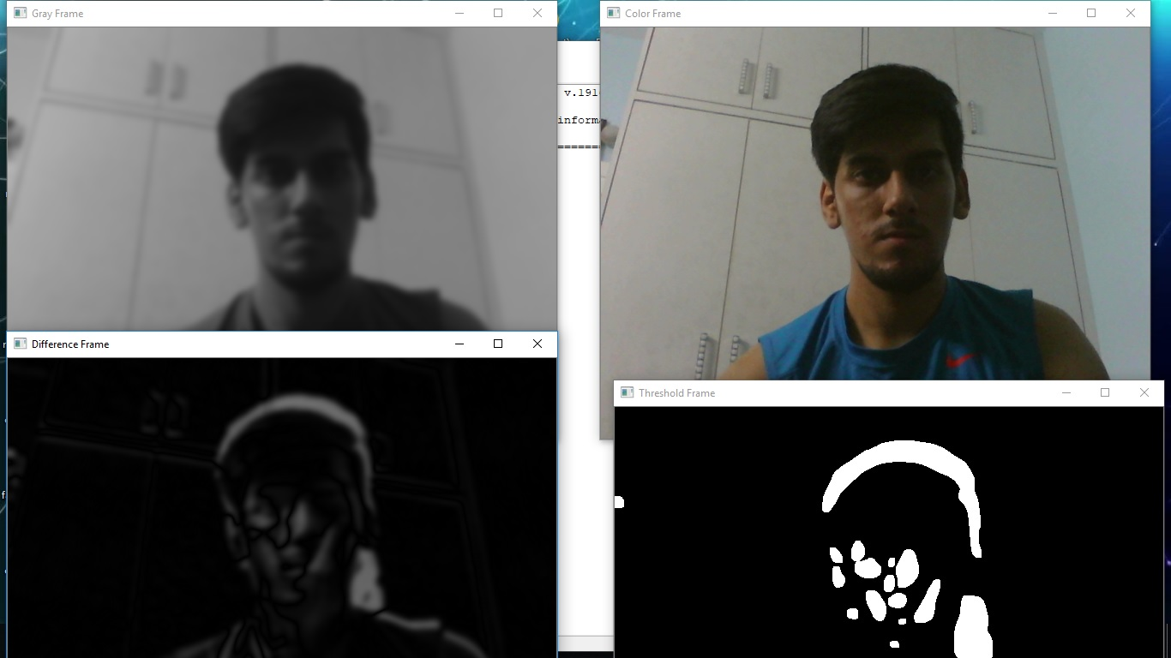
Suppose the first frame captured is :-
When there will be any movement it will show us the motion with green contour around the moving objects in Color frame or Difference frame shows the difference of intensities of first frame to the current frame and similarly in other frames.

Slide 5
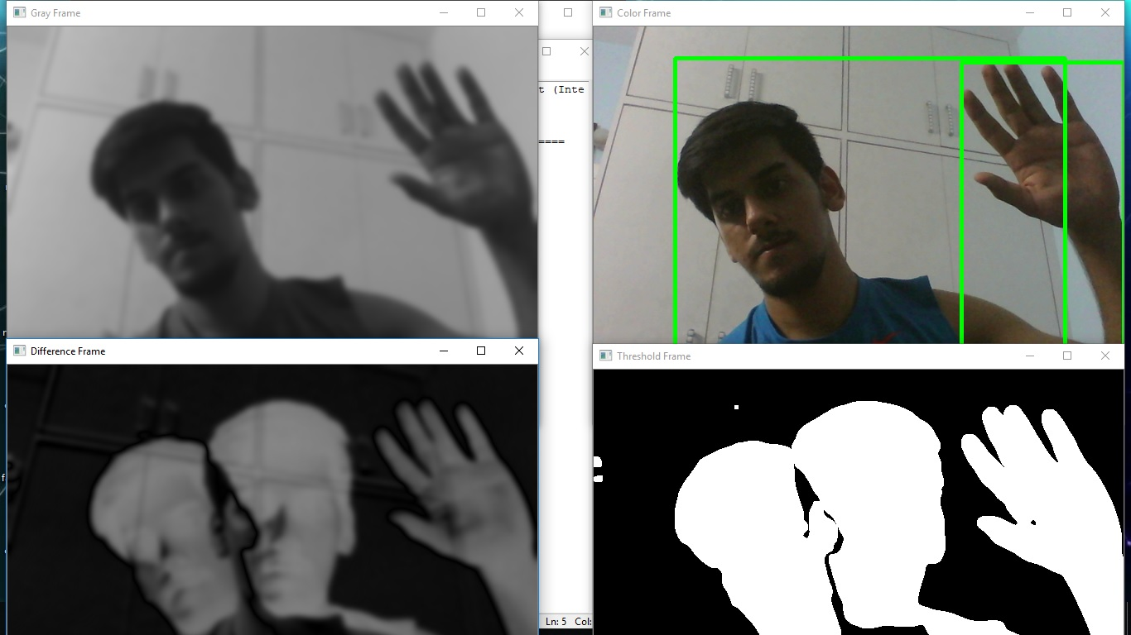
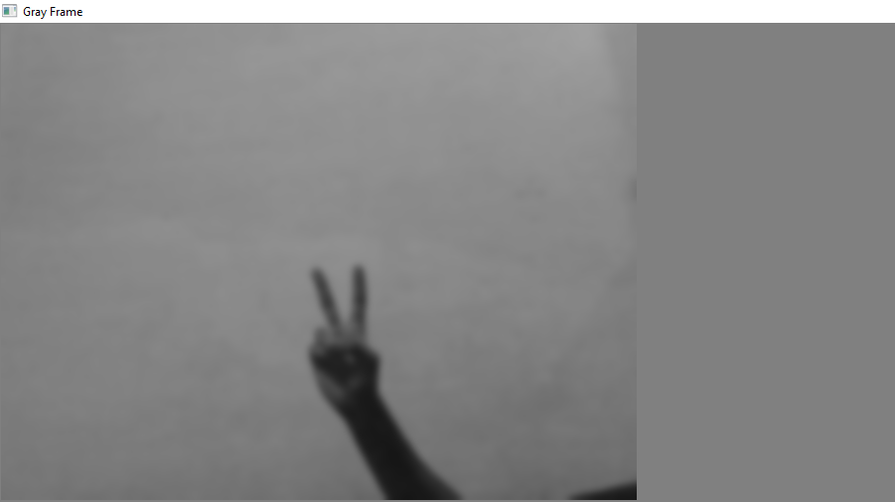
After running the code there are 4 new window will appear on screen
Let’s analyse it one by one:
Gray Frame : In Gray frame the image is a bit blur and in grayscale we did so because, In gray pictures there is only one intensity value whereas in RGB(Red, Green and Blue) image there are three intensity values. So it would be easy to calculate the intensity difference in grayscale.

Slide 6
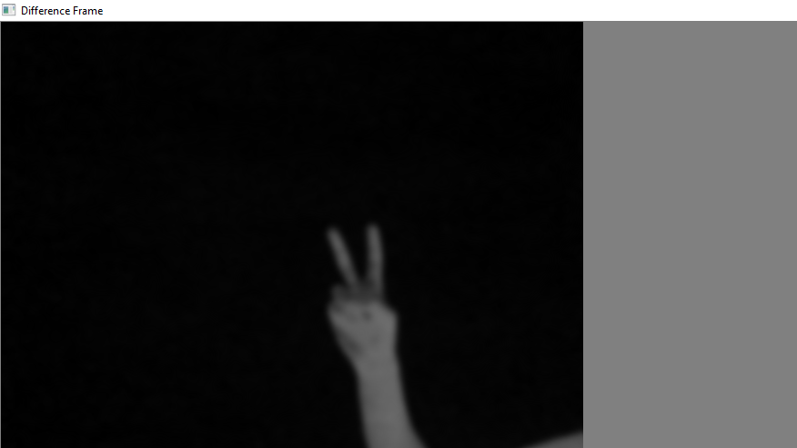
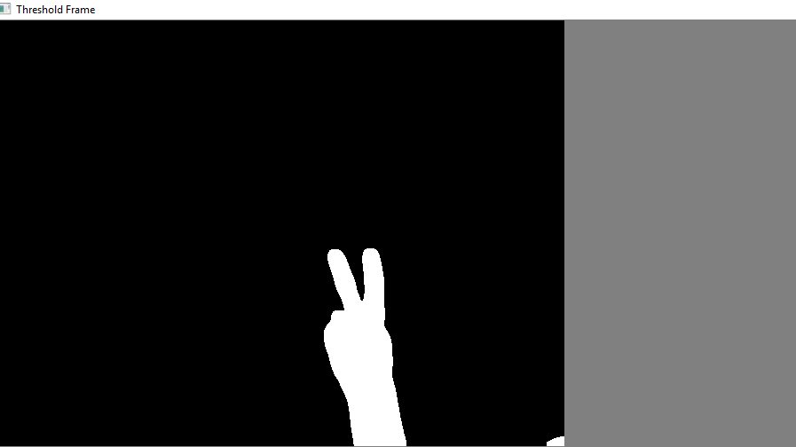
Difference Frame :
Difference frame shows the difference of intensities of first frame to the current frame.
Threshold Frame :
If the intensity difference for a particular pixel is more than 30(in my case) then that pixel will be white and if the difference is less than 30 that pixel will be black

Slide 7
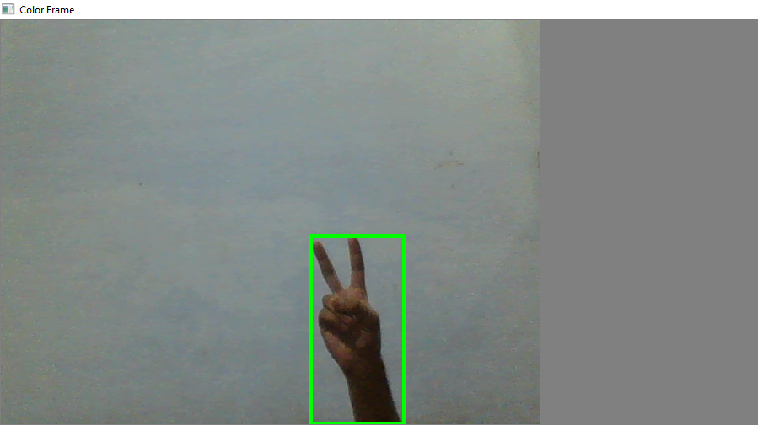
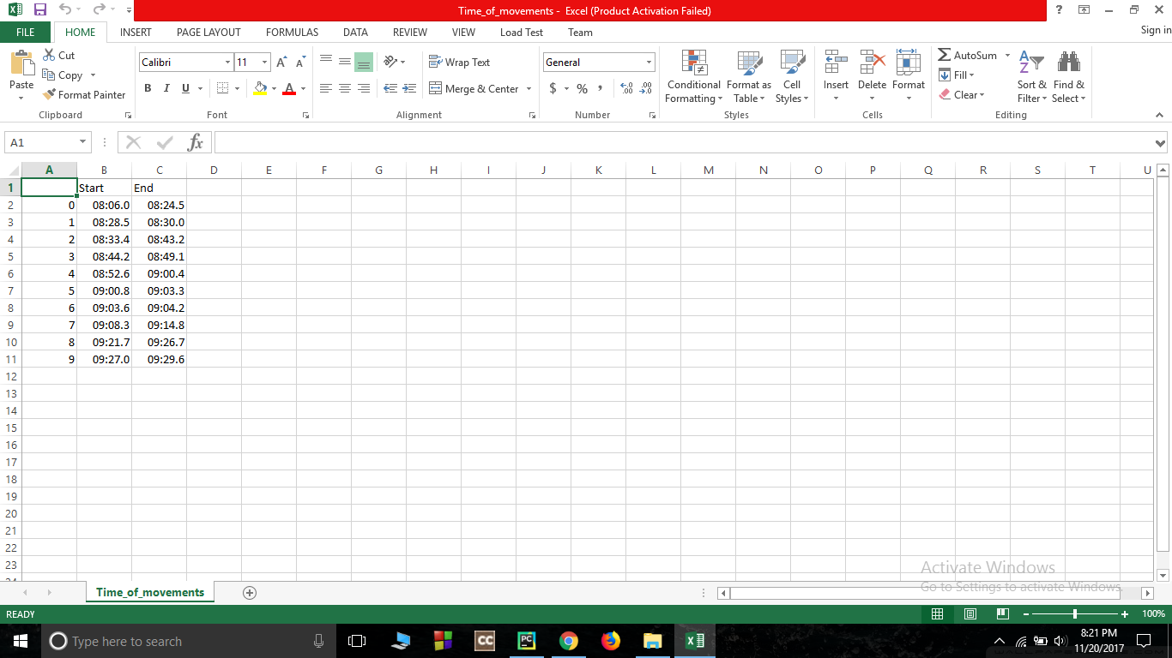
Color Frame :
In this frame you can see the color images in color frame along with green contour around the moving objects
Time Record of movements
The Time_of_movements file will be stored in the folder where your code file is stored. This file will be in csv extension. In this file the start time of motion and the end time of motion will be recorded. As you can see in picture:

Slide 8
Automated image QC
1. Validate if there is car in photo or not, if not send mail to customer to resend photos
2. Validate the car picture sent by customer matches with make model description that we have in policy, if fails send mail to client about mismatch
3. Match color of car in our records, if fails send mail to client about mismatch
4. Identify license plate and do zonal ocr on it and match with our records

Slide 9
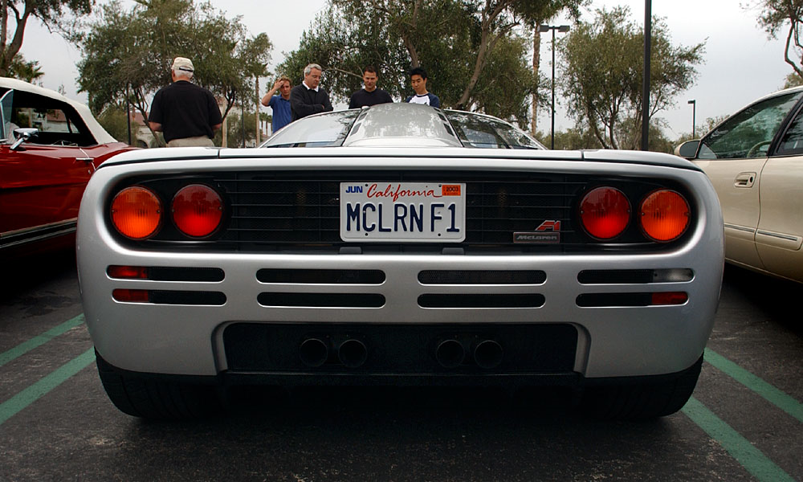
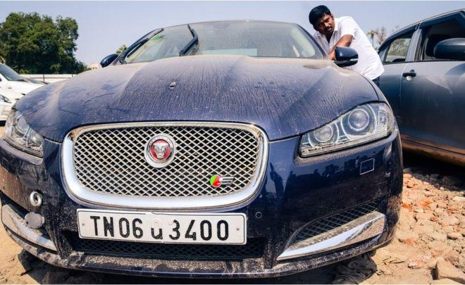
LICENSE PLATE RECNITION FROM THE IMAGE SEND BY
THE CLIENT FOR INSURANCE
PURPOSE
A high performance license plate recognition system (LPRS) is proposed in this work. The proposed LPRS is composed of the following three main stages: (i) plate region determination, (ii) character segmentation, and (iii) character recognition.

Slide 10
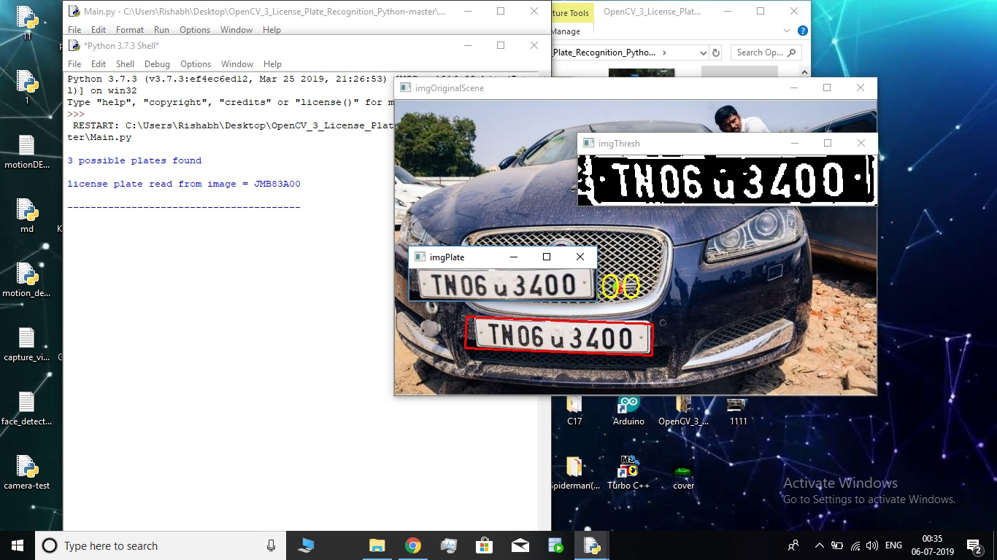
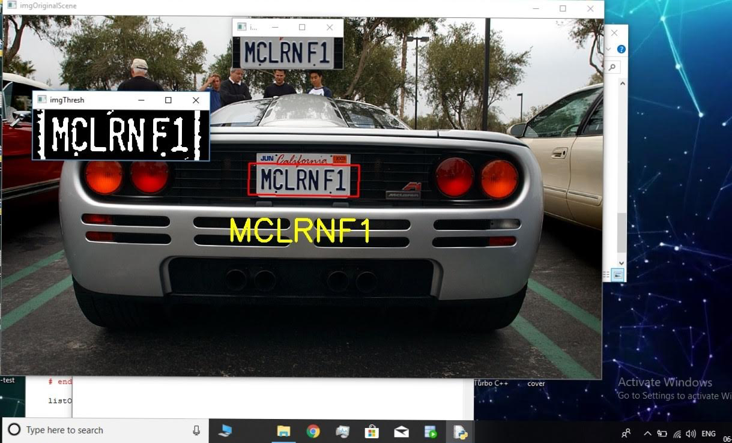
1) Plate Region Determination: detection of the rectangular LP region and extraction from the image.
2) Character Segmentation: separation of the characters on the LP region for the character recognition stage.
3) Character Recognition: conversion of image‐based characters into a textual expression.

Slide 11


